Slide 1
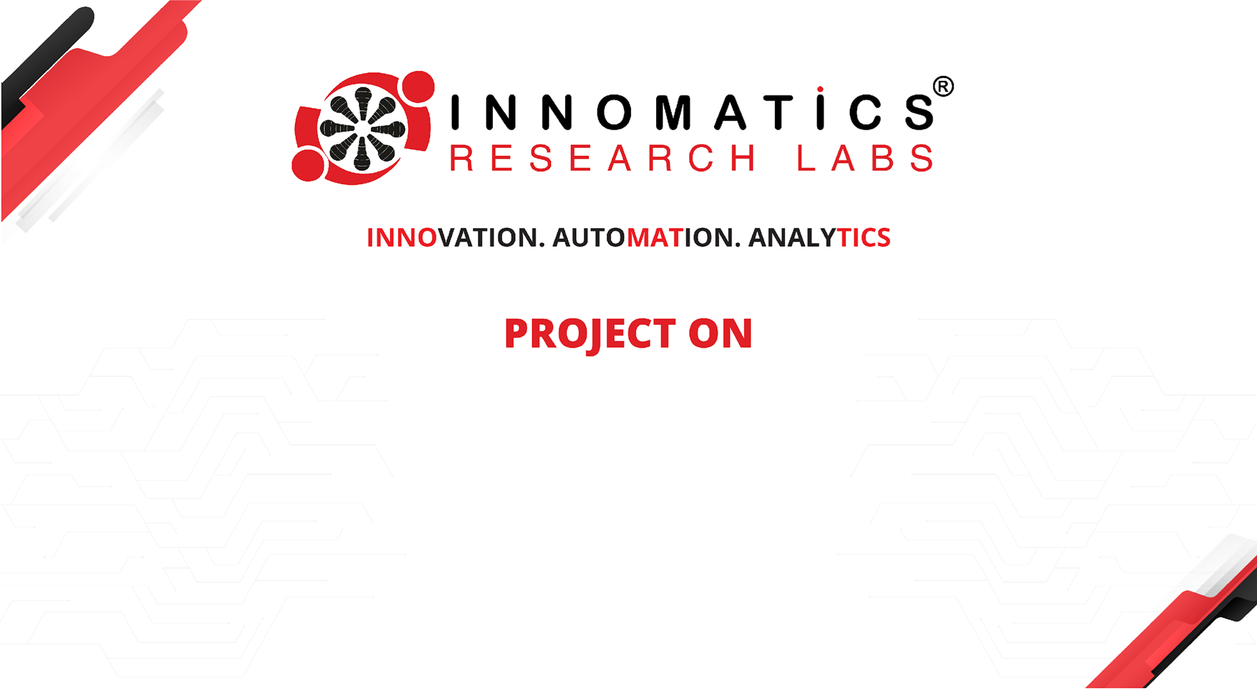
Code Refactoring and Bug Fixing

Slide 2
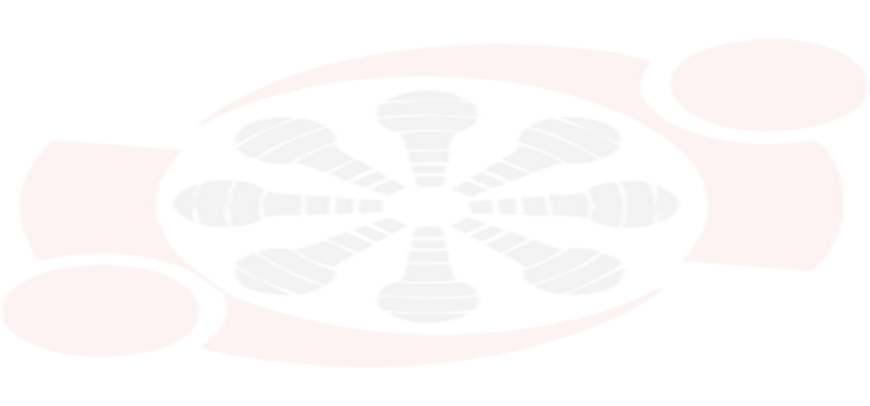

ABOUT ME
Name : Singireddy Pravalika
Qualification : MSC
Any work experience : Fresher
I want to learn data science for skills and to get a job in scientist field.
It has great job opportunities.

Slide 3
Scenario:
A team of enthusiastic data scientists embarked on a mission to develop a Note Taking Application using Python, Flask, and HTML.
However, their lack of experience in backend development has led to challenges in making the application fully functional.
Recognizing your proficiency in backend development, you have been tasked with fixing the broken code and ensuring the application works seamlessly.

Slide 4
Objective of the Project:
Refactor the existing codebase and ensure the proper functioning of the Note Taking Application.
Document all identified bugs during the debugging process.
Remember, the task is not about recreating the app from scratch.
Your goal is to fix the already existing codebase and make the application work as intended.

Slide 5
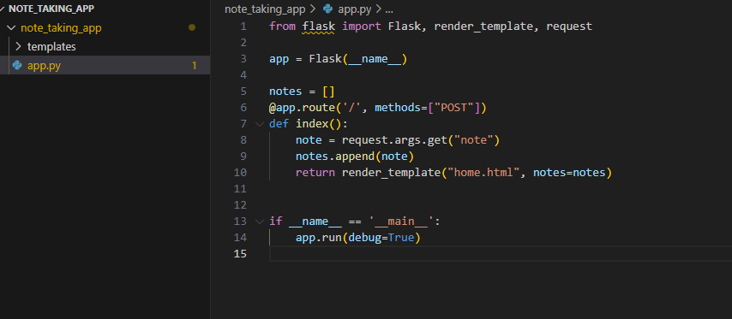
Identifying Bugs in the Application Server:

Slide 6
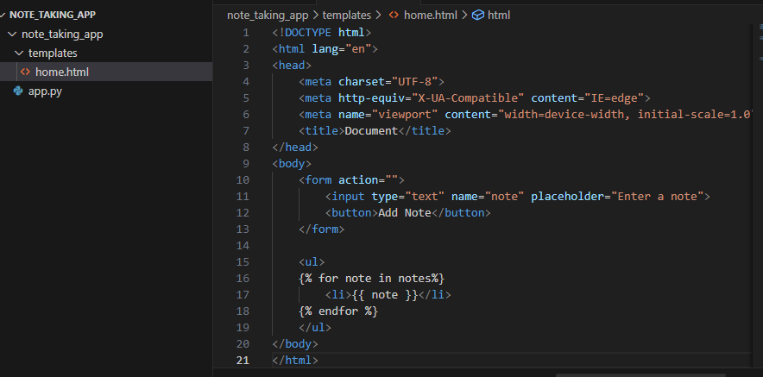
Identifying Bugs in the HTML Method:

Slide 7
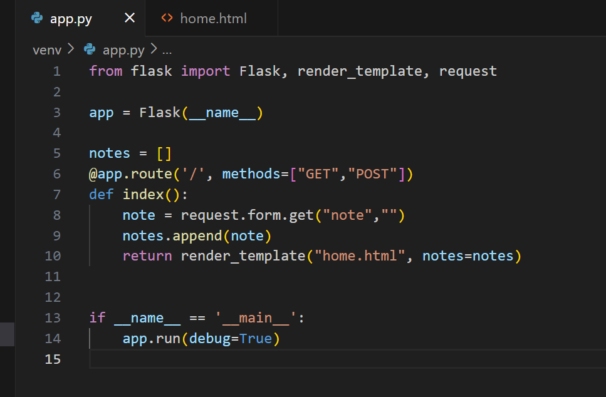
Fixing Bugs in the Application Server:

Slide 8
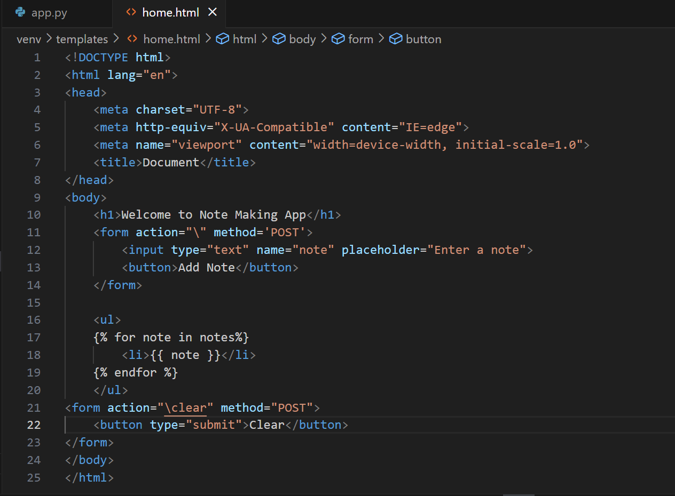
Fixing Bugs in the HTML Method:

Slide 9
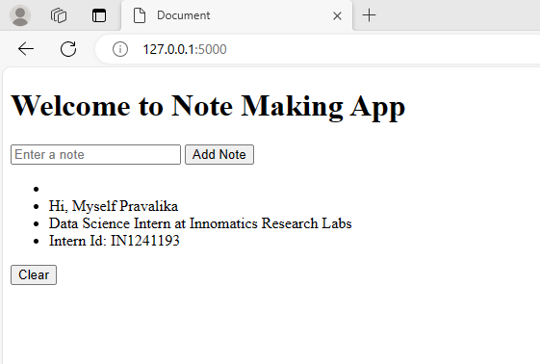
Output:

Slide 10
Conclusion:
Throughout this presentation, we have successfully addressed key issues and enhanced the functionality of our Note Taking Application.
The provided code has been refactored and identified bugs have been fixed.
Implemented features like handling empty notes and adding a “Clear” button to improve user satisfaction.
Code refactoring is conducted to improve readability and maintainability.

Slide 11



